Slide 1
Creacción Lecture
Cognitive Mechanisms in Creative Design
Steven M. Smith
Department of Psychology
Texas A&M University
Developing Pedagogical Models for Interdisciplinary Creation and Research Processes

Slide 2
Approaches to the Study of Creativity
Creative Products
Creative Personalities
Creative Processes

Slide 3
What is Creativity? Creative Processes
Creative Cognitive Processes
Knowledge/Skill
Divergent Production
Fixation
Intuitive Guiding
Opportunistic Assimilation
Mind Wandering
Visual Synthesis
Cognitive Restructuring
Structured Imagination
Abstract Thinking
Conceptual Combination
Analogical Transfer

Slide 4
Why do we need to study Creative Cognition?
To know how to train creative thinking.
To create new tools to support creative thinking.
To support the process of creative design.

Slide 5
Creative Cognition
Generative Processes
Exploratory Processes
Producing Ideational Structures
Exploring Ideational Structures

Slide 6
Creative Cognition
Generative Processes
Exploratory Processes
Divergent Production
Intuitive Guiding
Mental Play
Opportunistic Assimilation
Cognitive Restructuring
Structured Imagination
Abstract Thinking
Conceptual Extension
Conceptual Combination
Analogical Transfer

Slide 7
MIND-WANDERING
Highly volatile & easily distracted thinking, a scattered mind
“Attention becomes disengaged from the immediate external environment and focused on internal trains of thought.”
“a goal-driven process, albeit one that is not directed toward the primary task (Smallwood & Schooler, 2006)
Costs of mind-wandering: Reading, Attention, aptitude
What are some possible benefits of mind-wandering?
Incubation and Insight

Slide 8
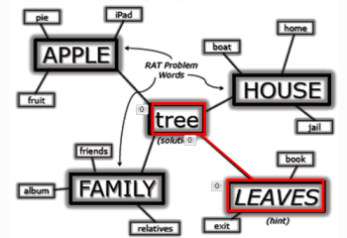
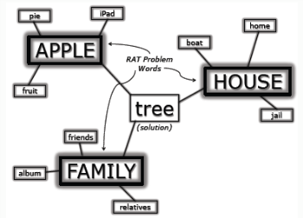
OPPORTUNISTIC ASSIMILATION
conscious
conscious threshold
unconscious
leaves
Boosting Activation Above Threshold

Slide 9
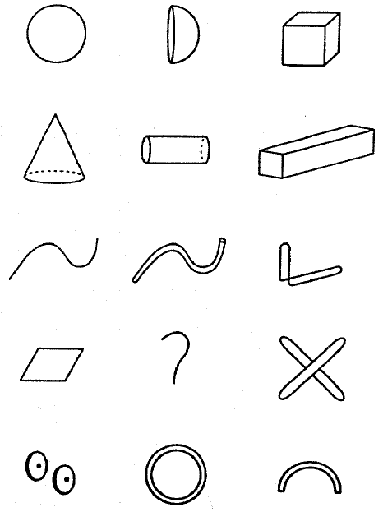
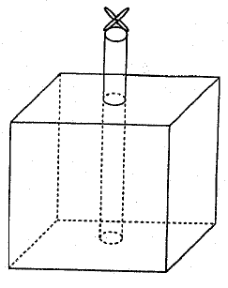
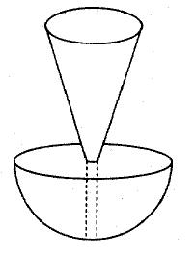
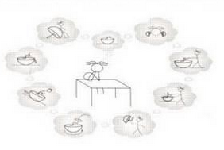

Mental Play: VISUAL SYNTHESIS
Playing with forms to generate
pre-inventive structures for exploring

Slide 10
Structured Imagination
New (creative) ideas are based on existing concepts and schemas.

Slide 11
Structured Imagination
New (creative) ideas are based on existing concepts and schemas.
Path of Least Resistance
Conceptual extension tends to begin with a basic level category, and then become more specific.

Slide 12
Redefining Problems
Abstraction promotes creative ways to redefine problems.

Slide 13
Redefining Problems
Abstraction promotes creative ways to redefine problems.
Abstract Thinking
Analogical Transfer
Conceptual Combination

Slide 14
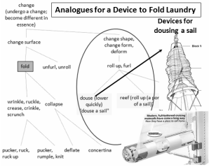
ABSTRACT THINKING
A hierarchical approach

Slide 15
Creative Cognition: A “Big Picture”
Generating Preinventive Knowledge Structures
Divergent Thinking
Intuitive Guiding
Fixation
Incubation & Insight
Exploring & Playing with Knowledge
Abstraction
Conceptual Extension
Analogical Transfer
Conceptual Combination

Slide 16
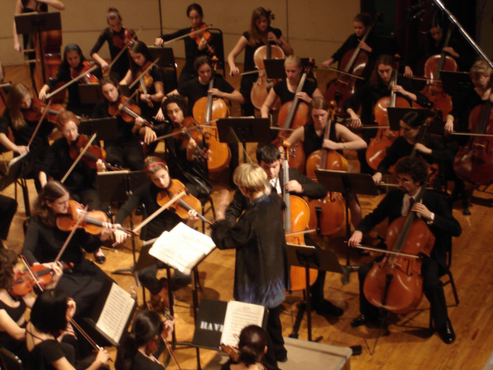

Creative Cognition
A flexible collaboration of many different cognitive processes, each contributing in its own way.

