Slide 1
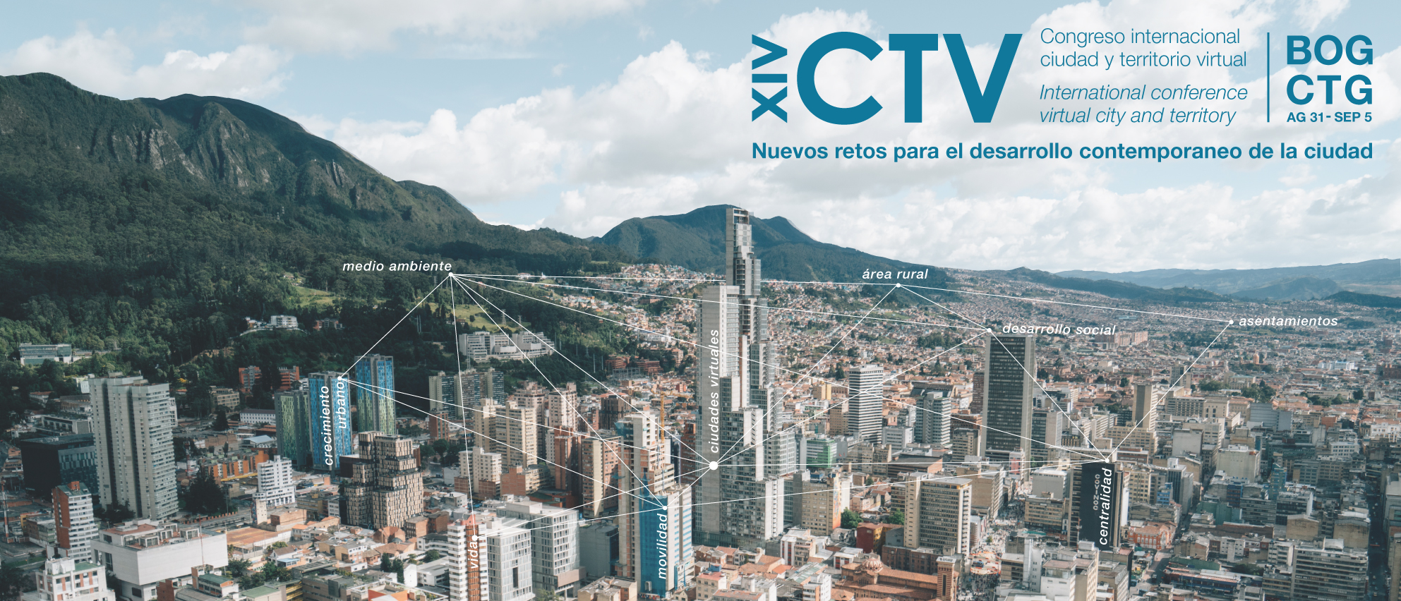
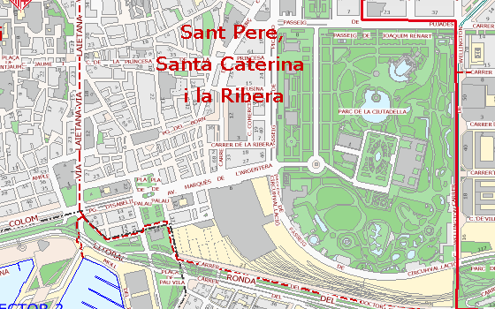
XIV International Conference Virtual City and Territory CTV
Universidad de Bogotá Jorge Tadeo Lozano / Universitat Politècnica de Catalunya –
Centro de Política del suelo y Valoraciones - CPSV
September 26th - 30th 2022
Title of the work [Typeface title, Arial 40, bold]
Surname, Name (1); Surname, Name (2) y Surname, Name (3) [Typeface title, Arial 26]
1) First author affiliation; (2) Second author affiliation; (3) Third author affiliation [Typeface, Arial 20]
E-mail contact first author; E-mail contact second author; E-mail contact third author[[Typeface, Arial 20]
If photographs are not authorized, the not allowed logo must be maintained.
Abstract [Typeface section title, Arial 26, bold]
1. Introduction [numbered]
3. Results
Section text typeface. [Arial 20, paragraph justified on both sides]
The design of the poster content may be modified, provided that it complies with the following guidelines :
Vertical format DIN A0 (841 X 1189 mm)
Adhere to the format of the poster header (poster template)
Comply with the size and style requirements for text and headings..
General margin and spacing between text blocks and columns is 1 cm..
The height of the text columns can be modified..
Composition in three text blocks. Each 267 mm wide.
At least an abstract, introduction, methods and results of the work should be included (other sections can be freely added as shown in this sample template or some sections such as references can be deleted.).
Text.
Text. Example of title and table notes (Table 1).
Tabla 1. Size and style of title [Arial 18, bold]
 | Size | Capital letters | Bold | Italic | Numbered
Title of the work | 40 | Y | Y | N | N
Authors | 26 | N | N | N | Y
Information of the authors | 20 | N | N | N | Y
Title of the sections | 26 | * | Y | N | Y
Subtitle of the section in the text | 22 | * | N | Y | Y
General text in the sections | 20 | N | N | N | N
Text in tables | 14 - 18 | N | * | * | N
Emphasis in the text | 20 | N | N | Y | N
Titles of figures and tables | 18 | N | Y | N | N
Notes of figures and tables | 16 | N | N | N | N
* Not required but it can be used to emphasize
Source : CPSV [Arial 14]
2. Methodology and data
4. Conclusions
Text.
2.1. Section subtitle in text [Arial 22, numbered]
Text. [double spacing between headings and text]
Example of figure and notes (Figure 1). Figures or blocks of text can be in double columns, as in this example.
Text.
Figure 1. Map of a section of Barcelona [Arial 18, bold]
5. References
Text.
Source: Guia Urbana de la Ciutat (Ajuntament de Barcelona) [Arial 16]
Acknowledgments
Text.

