Slide 1

AIESEC IN HUNGARY
2030
WHO AM I?

Slide 2
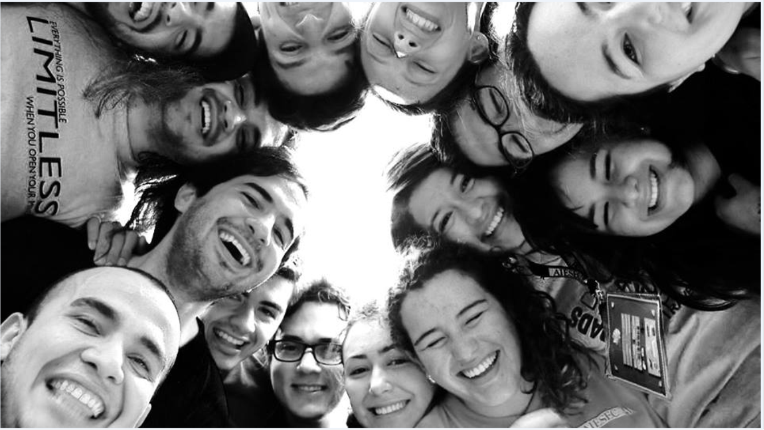

Let me tell you !!

Slide 3
2025-2035: A powerful group of people, including Paula Andrea Castro and other 1.000.000. Billion of leaders , start to create Fulfillment and Humankind´s potential Bank. This bank provide the possibility for all the youth to join an internship once in a live and contribute creating any project or Start up for any human right problematic that the person wants to create.
This Bank since 2030 recognized with Sweden Nobel prize for people who change realities and contribute for Human right s issues inside all the countries and territory's that the World have.
This is a story of one of the leaders who join AIESEC in the 2010-2020 decades and permit this kind of contribution in the world

Slide 4
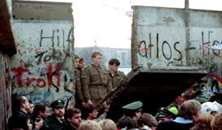
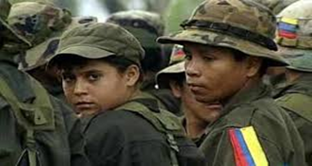
1989: the fall of the Berlin Wall. One of the most important historical facts in that time. The youth start
to be come aware of the Worlds Issues.
1991: Paula Andrea Castro was born in Bogotá Colombia. 1991 was one of the most tragic and unsafe year in her country. The corruption and terrorist attack ruled the territory.

Slide 5
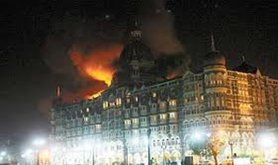
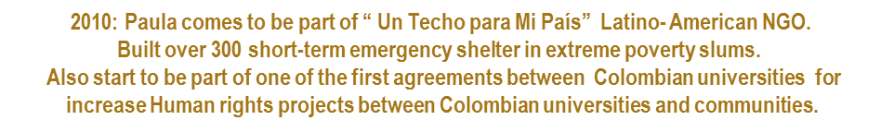
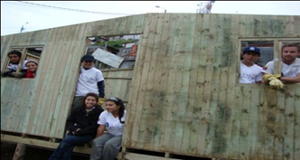

Slide 6
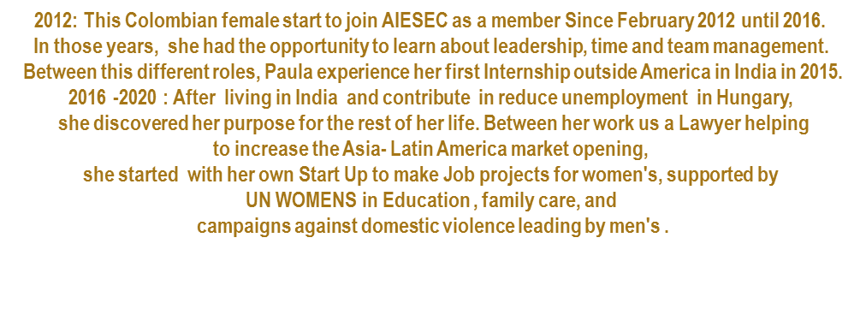


Slide 7
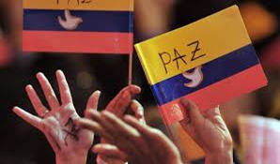

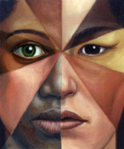


2016-2025: Colombia signed peace and end the civil war inside the country.
Hungary Japan, Malaysia, Argentina and another emerging economies start to create the
The Model Nation Project assumes that all the democracy need
Modern politics, means for including all the human problematics and lead by High schools,
Universities and Company's as a fact for continue the education,
equal rights, respect of social, religion, opinion difference.
This project was supported economically and socially by AIESEC Alumni Network
( Including Paula as the leader In her country)
Model nations project.

Slide 8
Sounds great no?
This is the real solutions that I would like to do as a human ,
for that reason I join AIESEC
because I believe that we have the power to change realities
and make this world a better place

Slide 9
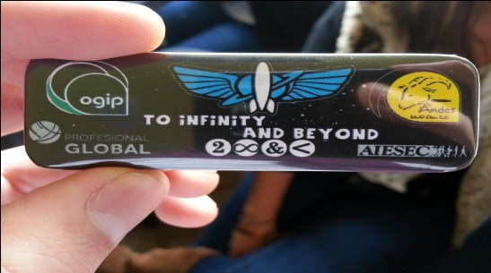
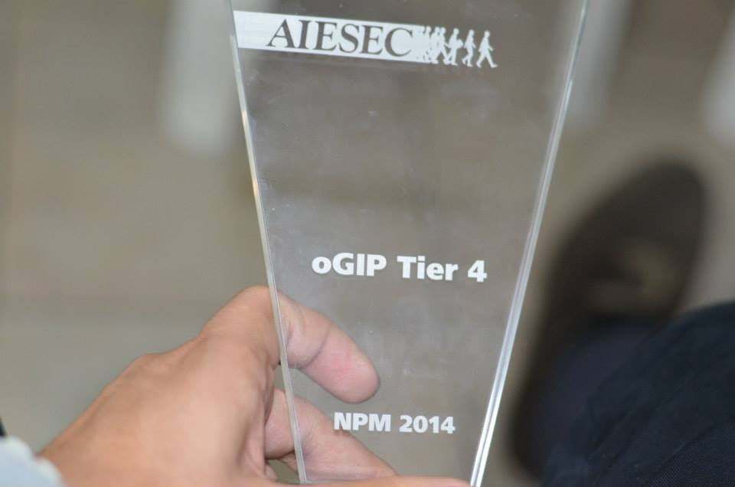
AIESEC EXPERIENCE
ROLES
IGIP Team Member Feb 2012- Dec 2012
UR Team Leader Jan 2013- June 2013
oGIP Team Leader Aug 2013- Dec 2013
oGIP LCVP Jan 2014 – Dec 2014
oGIP @COL – IGIP @INDIA CEEDer 9 Dec- 24 Jan 2015
EP GIP Chandigarh Feb – April 2015
BEST UR TEAM LEADER
AIESEC Andes
OCVP Comm Youth to Business Forum, Bogotá Dec 2012
BEST OGIP AIESEC IN COLOMBIA 2014
FACI Experiences
Local introduction conference: Neiva / Huila – Colombia
Local Introduction conference : AIESEC Andes Feb 2014
Local Introduction conference: AIESEC Andes Aug 2014
Local Introduction Conference: AIESEC Cali/ Valle del Cauca – Colombia
December leadership conference – Chair: AIESEC Delhi IIT
National Leadership Summit – OGIP commission : AIESEC India 2015
Local Introduction Conference : Ludhiana – Punjab – India

Slide 10
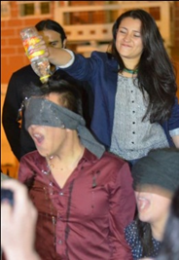
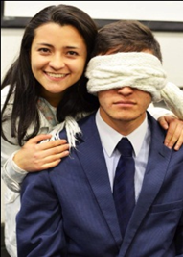

My Contribution as an AIESECer
- 50-56 oGIP EPs in Brazil, USA, India, Mexico, Argentina, Switzerland, Germany.
- 3 Agreements between Universities and AIESEC for: Quarter Payments, Social media diffusion (Data bases, class rooms, conferences): Andes University, Jorge Tadeo University, Externado de Colombia University.
- Two LCVPs oGIP in AIESEC Andes for 2015
Pipeline EPs 2015
But the most important contribution is the roles that my Members and TL´s are taking after my TL and LCVP role, and the still contribute in AIESEC. 1 LCVP 2013 and 3 LCVP´s in 2015.

Slide 12
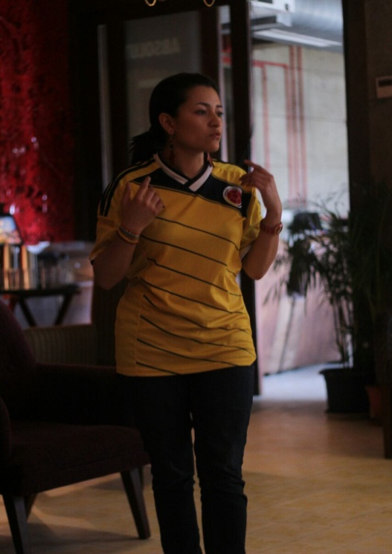
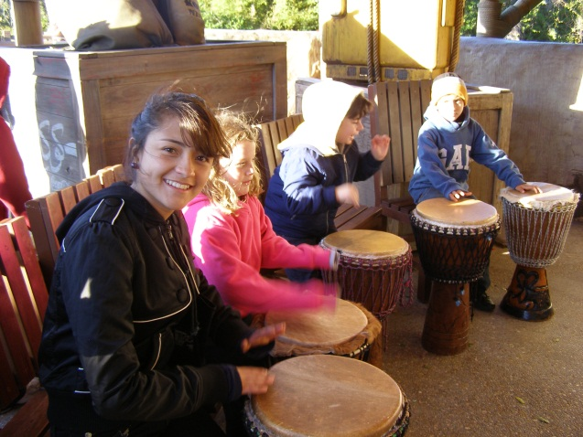
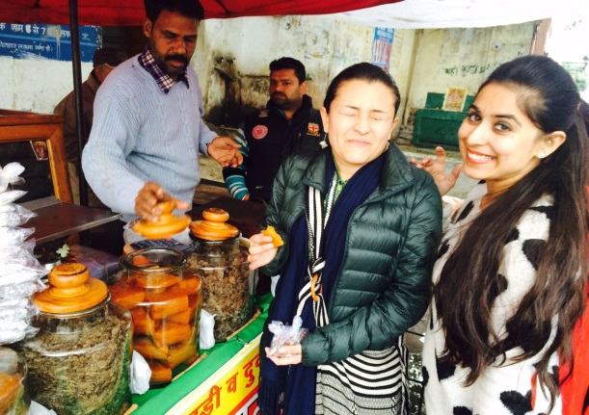
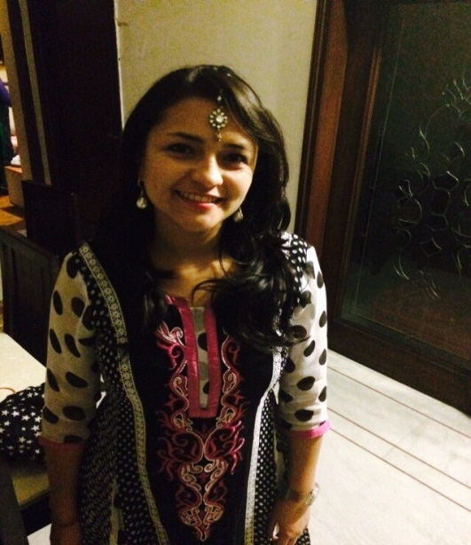
Paula Andrea castro
I Love music, I can´t work without music
I love eat and taste everything
I love read about history and watch movies

Slide 13
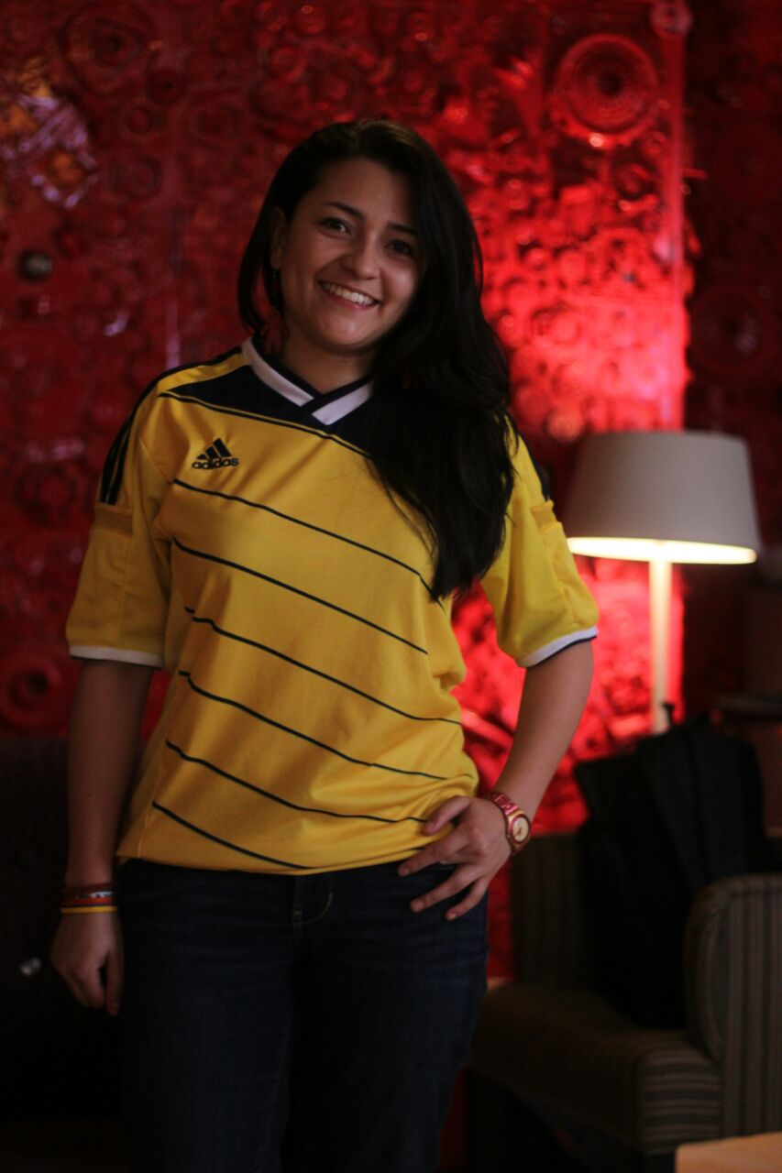
I´D MADE IT THIS FAR AND REFUSED TO GIVE UP BECAUSE ALL MY LIFE I HAD ALWAYS FINISHED THE RACE
LOUIS ZAMPERINI

